Slide 1
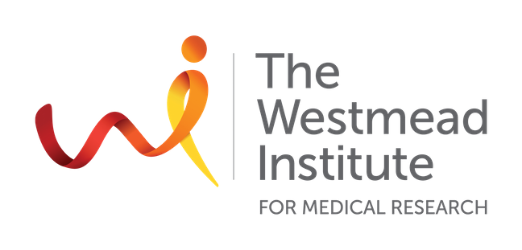

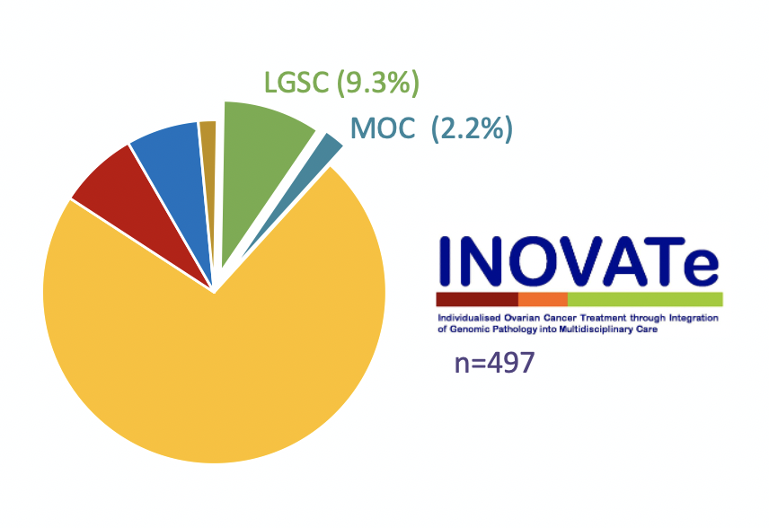
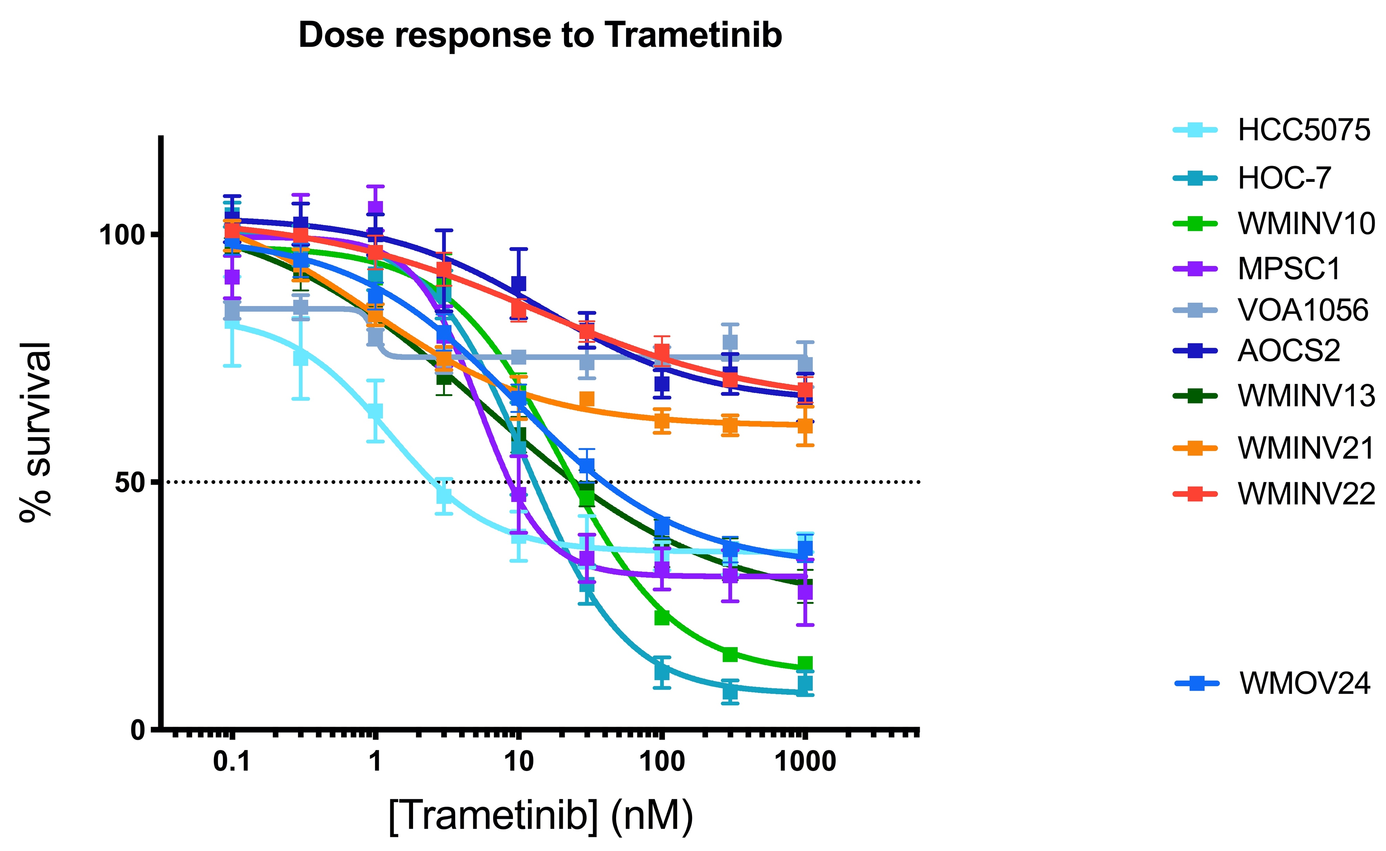
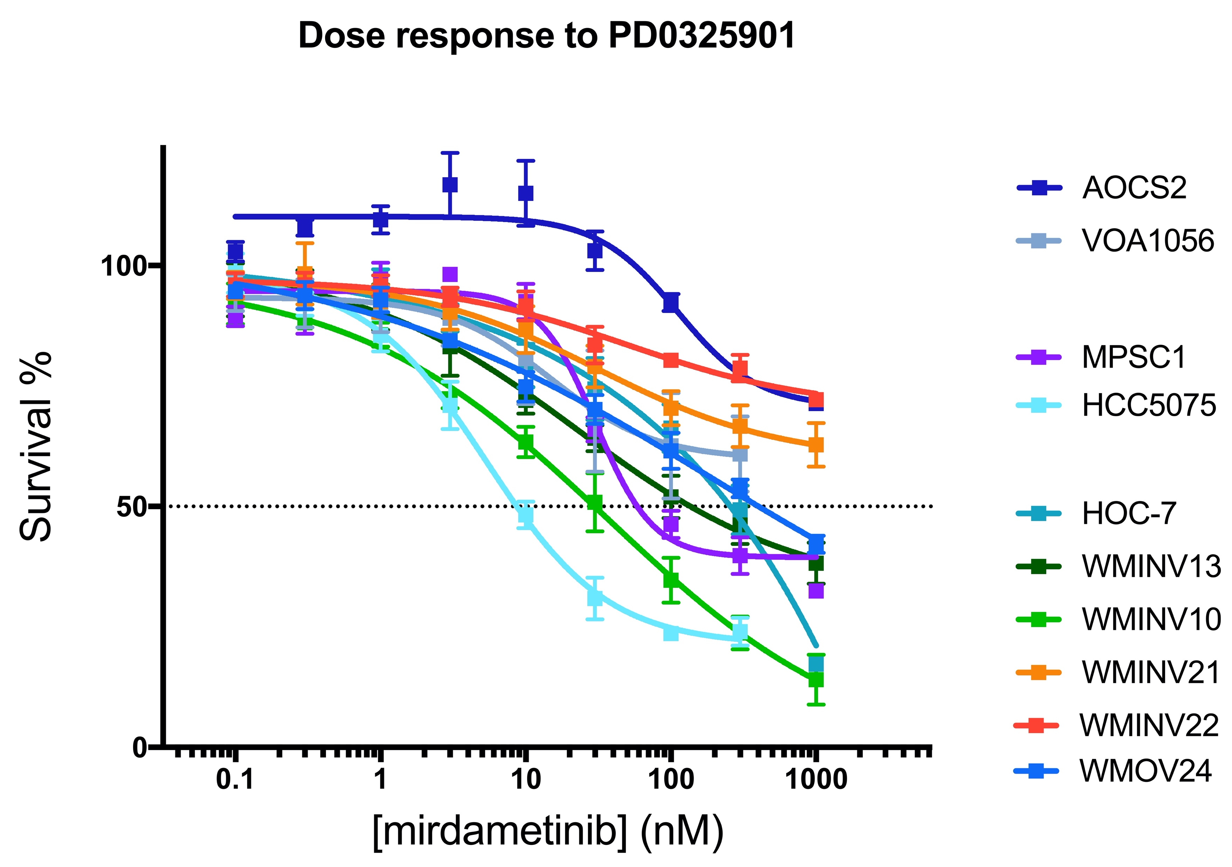
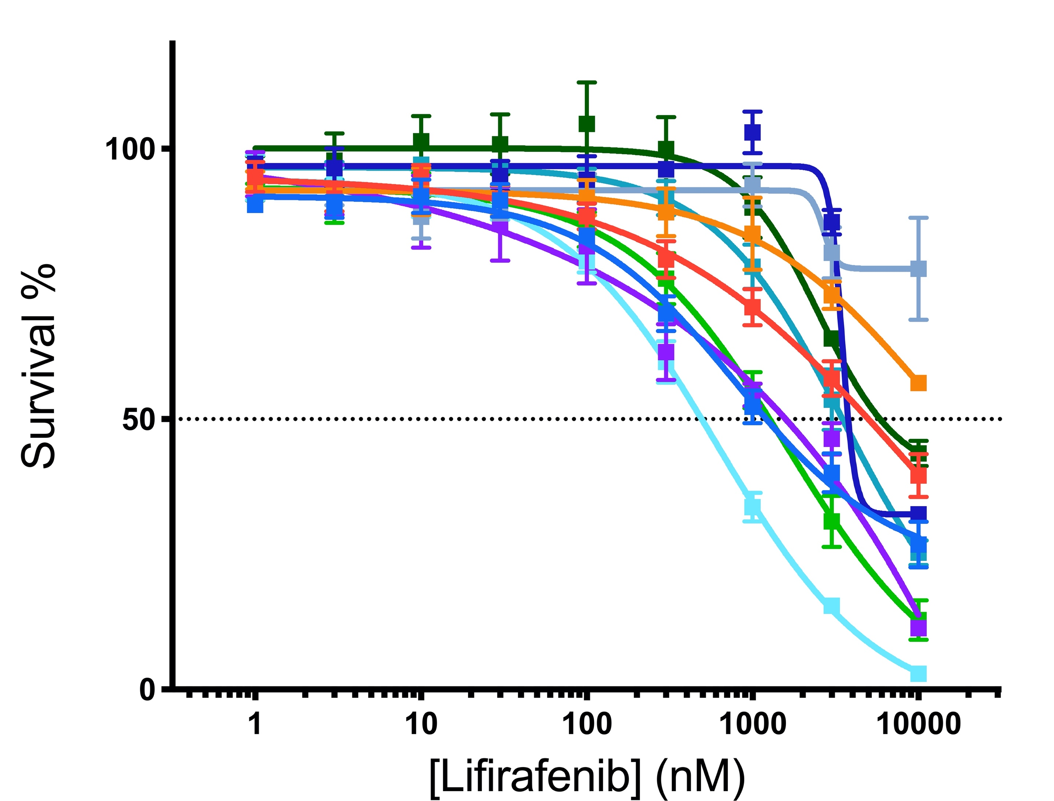
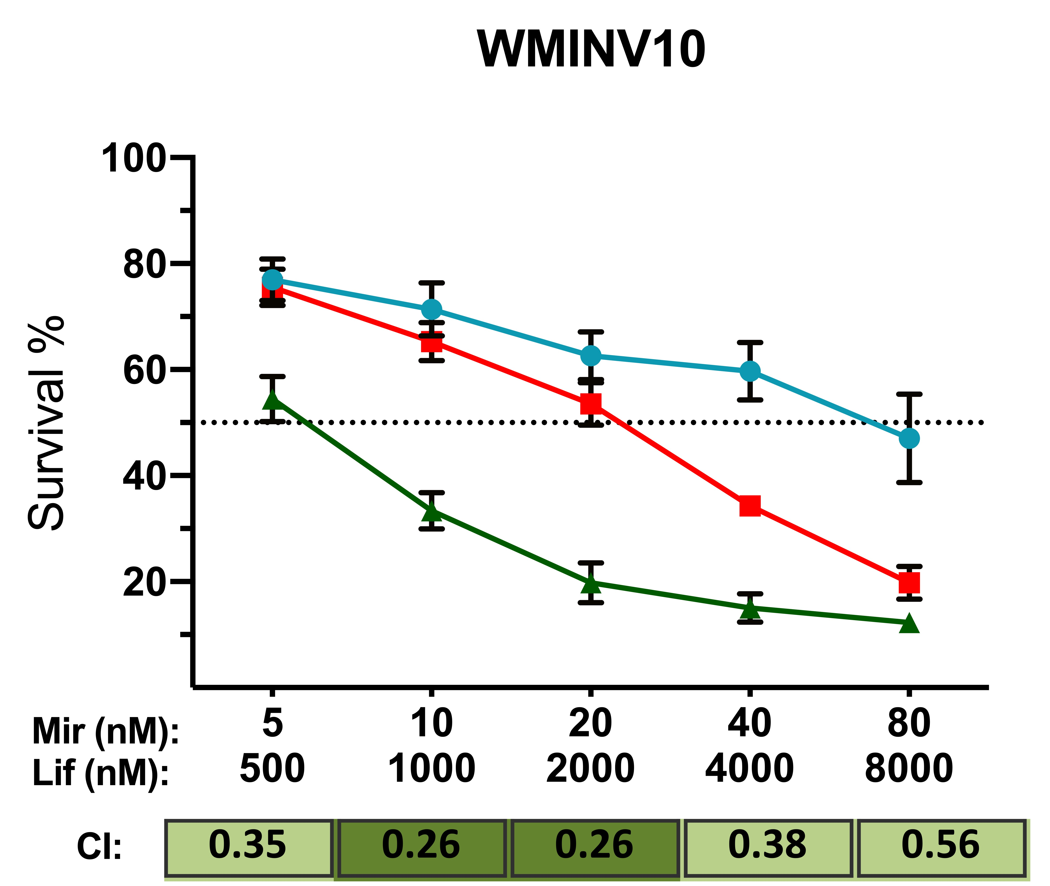
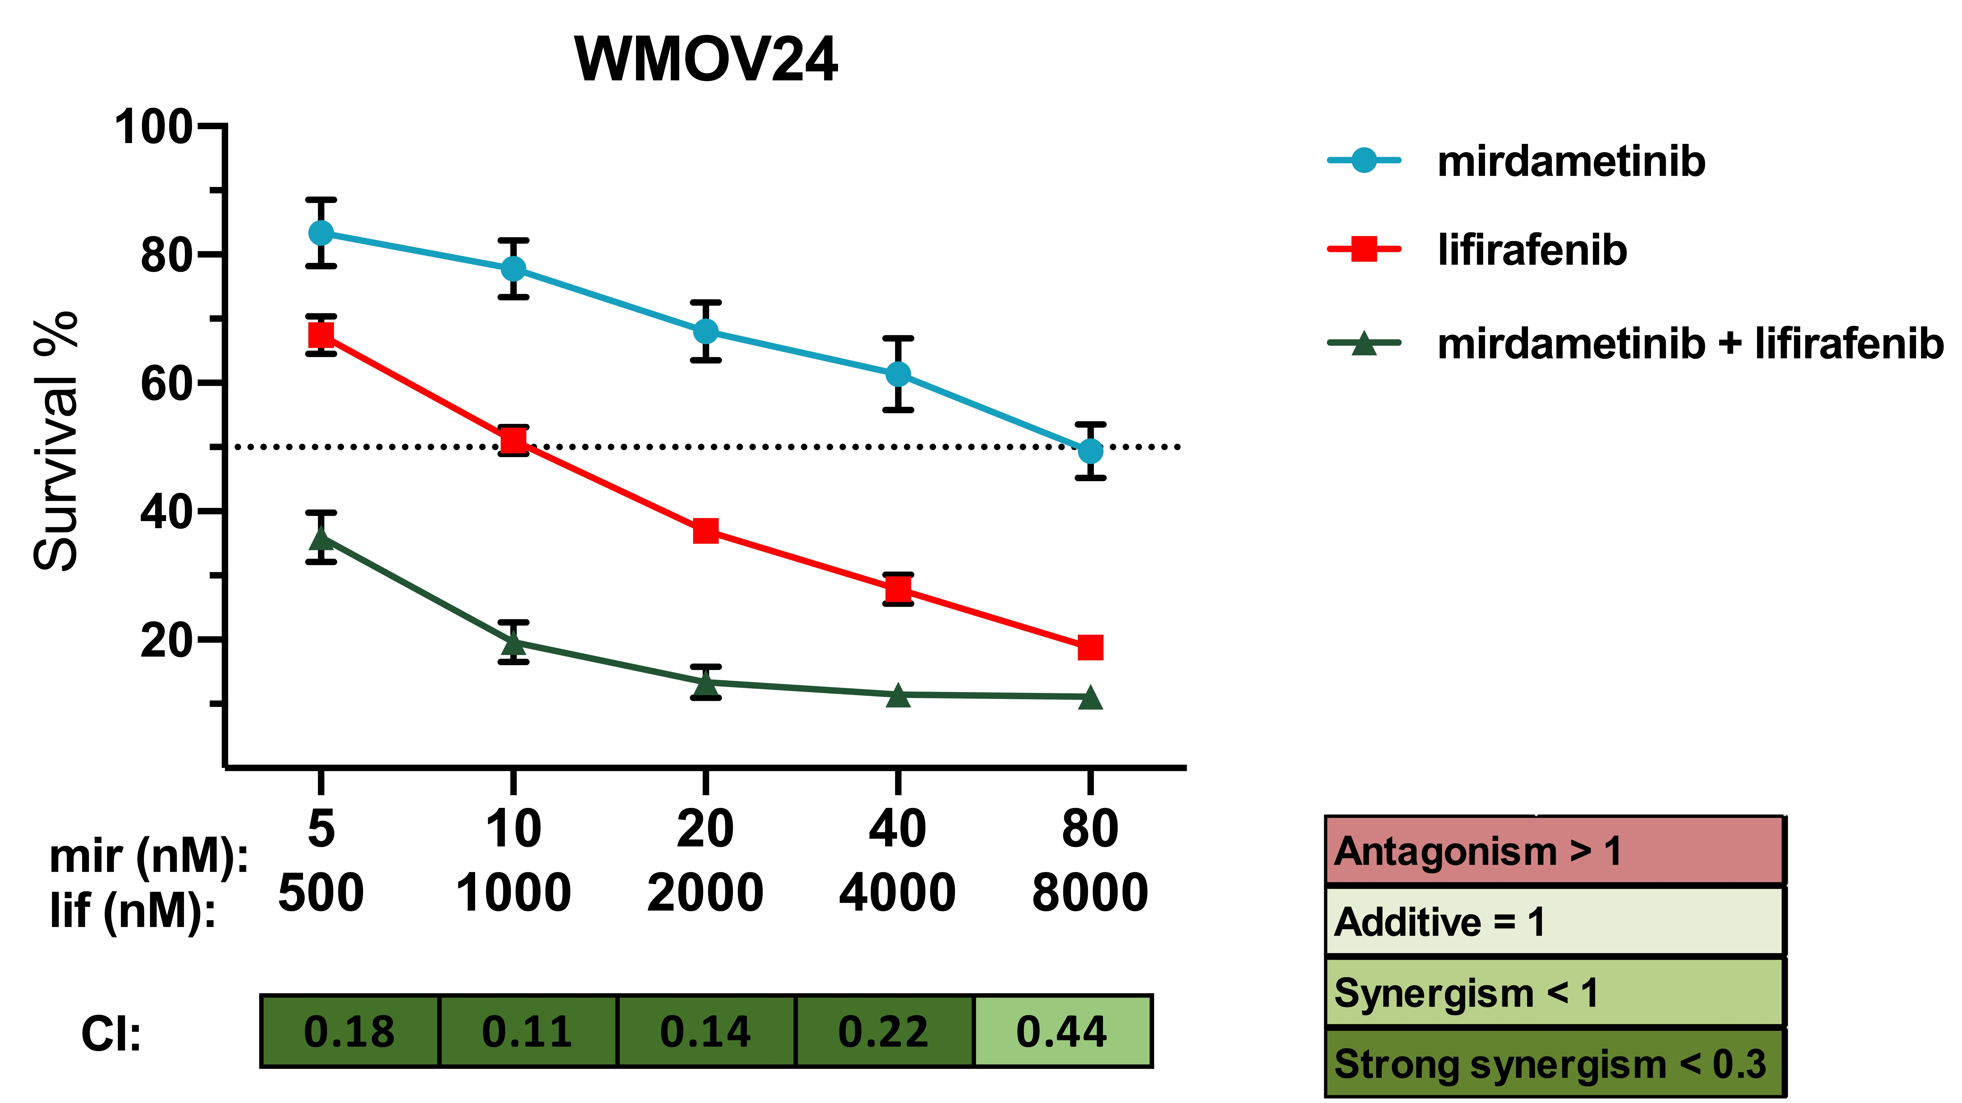
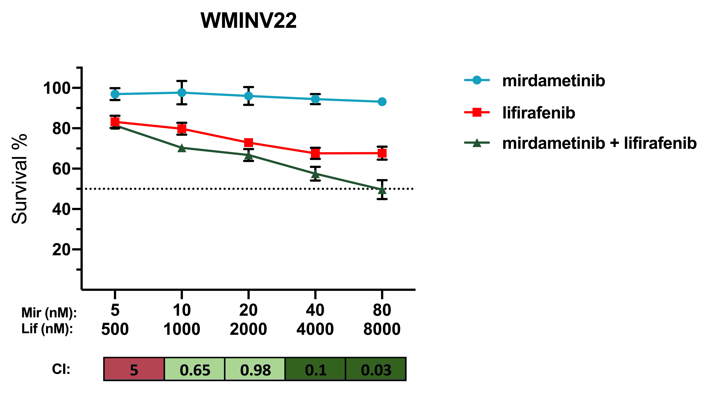



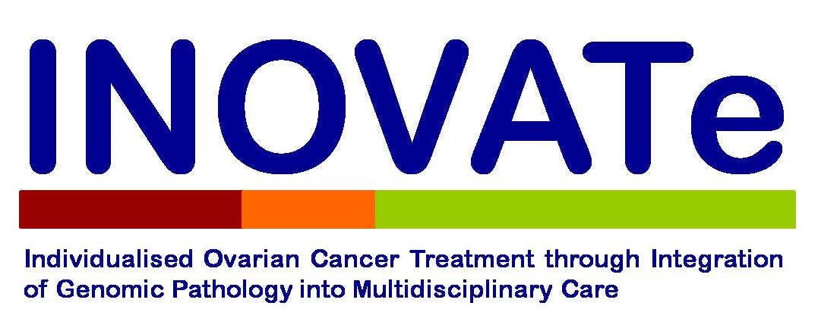

Targeting the RAS/MAPK pathway in low-grade serous and mucinous ovarian cancer
Ida Madsen^{1*}, Tania Moujaber^{1,2,3,4*}, Bo Gao^{1,3,4}, Pamela Provan^{1,2,3,5} for the INOVATe Investigators, Sivatharsny Srirangan¹, Cristina Mapagu^{1,2,6}, Natalie Bouantoun¹, Catherine J Kennedy^{1,3,5}, Yoke-Eng Chiew^{1,3,5}, Jessica Boros^{1,3,5}, Nikilyn Nevins^{1,2,3,5}, Raghwa Sharma^{2,3,7}, Nadia Traficante^{8,9} for the Australian Ovarian Cancer Study Group, Michael Friedlander^{10,11}, Goli Samimi¹², Alison Brand^{2,3,5}, Deborah J Marsh¹³, Phillip Beale^{2,14}, Lyndal Anderson^{2,15}, Dale W Garsed^{8,9}, Kylie Gorringe⁸, Susan J Ramus^{16,17}, David DL Bowtell^{8,9}, Rosemary L Balleine^{2,18}, Paul R Harnett^{1,2,3}, Anna DeFazio^{1,2,3,5}
¹ Westmead Institute for Medical Research, Westmead, NSW, ² University of Sydney, Sydney, NSW, ³ Crown Princess Mary Cancer Centre, Westmead Hospital, Westmead, NSW, ⁴ Blacktown Hospital, Blacktown, NSW, Australia, ⁵ Department of Gynaecological Oncology, Westmead Hospital, Westmead, NSW, ⁶ Illawara and Shoalhaven Cancer Care Centres, ⁷ NSW Health Pathology and University of Western Sydney, Westmead, NSW, ⁸ Peter MacCallum Cancer Centre, Victoria, ⁹ Sir Peter MacCallum Department of Oncology, The University of Melbourne, Victoria, ¹⁰ Prince of Wales Clinical School, UNSW, Randwick, NSW , ¹¹ Nelune Comprehensive Cancer Centre, Royal Hospital for Women, Randwick, NSW, ¹² National Cancer Institute, MA, USA, ¹³ University of Technology Sydney, Sydney, NSW, ¹⁴ Chris O’Brien Lifehouse, Sydney, NSW, ¹⁵ Department of Tissue Pathology and Diagnostic Oncology, Royal Prince Alfred Hospital, Sydney, NSW, ¹⁶ School of Women’s and Children’s Health, UNSW, Randwick, NSW, ¹⁷ Adult Cancer Program. Lowy Cancer Research Centre, Sydney, Australia, Randwick, NSW. ¹⁸ Children’s Medical Research Institute, Westmead, NSW. * Authors contributed equally
Background
Figure 1. Frequency of RAS pathway mutations in LGSC tumours (n = 42 patients) and MOC (n=10).
Background
Low-grade serous ovarian cancer (LGSC) and mucinous ovarian cancer (MOC) are rare morphologically and molecularly distinct subtypes of ovarian cancer with poor response to platinum-based chemotherapy. However, unlike the most common subtype, high-grade serous, LGSC and MOC have activating RAS/RAF alterations (Figure 1), providing new therapeutic opportunities.
Aims
Establish a panel of cell lines with the spectrum of RAS/RAF alterations found in patients with LGSC and MOC
Test response to potential new agents, including those targeting the RAS/MAPK pathway
Methods
Ovarian tumour samples from 497 women were analysed by next-generation sequencing (30-gene custom Qiagen panel, Illumina MiSeq, AGRF). Five new primary cell lines were established from women with LGSC, recruited to INOVATe or GynBiobank (WMINV10, WMINV13, WMOV24) or MOC (WMINV21, WMINV22); and five LGSC cell lines were obtained from collaborators (AOCS2, MPSC1, VOA1056, HCC5075, HOC7). Cell lines were characterised by mutation testing and whole genome copy number profiling (Illumina Infinium Human OmniExpress-24 BeadChip arrays, AGRF). Inhibition of BRAF (lifirafenib), MEK (mirdametinib, trametinib) and CDK4/6 (palbociclib, abemaciclib) alone and in combination were investigated using live cell imaging (IncuCyte) and MTS proliferation assay (Promega, WI, USA).
Results
Figure 2. Dose response curves of LGSC and MOC cell lines to MEK/BRAF inhibitors; A) trametinib B) mirdametinib and C) lifirafenib. Effect of combining the MEK inhibitor mirdametinib with the BRAF-dimer inhibitor lifirafenib in LGSC cell lines; D) WMINV10 and E) WMOV24 and MOC cell line; F) WMINV22.
Figure 3. A) Cell line panel and sensitivity to drugs targeting the RAS-MAPK pathways and combination treatments. B) Potential drug targets in the RAS-MAPK pathway.
B
A
B
C
A
LGSC
MOC
Combinations
D
E
F
Conclusions
Heterogeneity was seen with respect to underlying driver mutation and response to MAPK pathway inhibitors
MAPK pathway inhibitors show response as single agents in some cell lines but combination strategies were more effective (figure 2, figure 3)
KRAS-mutated LGSC appear to be the most sensitive to combination MEKi/BRAF-dimer inhibitor (mirdametinib and lifirafenib) (figure 2D,E)
One of two MOC cell lines were also sensitive (figure 2F), suggesting that mirdametinib and lifirafenib is a combination to be further explored in MOC
Acknowledgements
INOVATe Investigators, GynBiobank, Australian Ovarian Cancer Study Group
We sincerely thank the patients who made this study possible and our consumer representatives, Sapna Lazarus and Janet Taylor
We thank Dr Shih (The Johns Hopkins University, Baltimore, Maryland), Dr Gazdar (University of Texas, Southwestern Medical Center, Texas), Dr Anglesio (University of British Columbia, Vancouver) and Prof David Bowtell (Peter MacCallum Cancer Centre, Melbourne) for providing cell lines. Funding: Cancer Council NSW (RG-15-23) and Cancer Australia (APP1142697).
The INOVATe study has received funding from the Cancer Institute NSW (Translational Program Grant 14/TPG/1-15), the Cancer Council NSW (Translational Program Grant TPG 20-01) and the University of Sydney.

